Slide 1


Slide 2

Review jQuery
.attr(), .find(), .addClass()
jsfiddle.net/7bufY/1

Slide 3

Today’s Outline
More jQuery
Forms
Final Note

Slide 4
Goal Today:
More jQuery Practice & Forms

Slide 5
More jQuery

Slide 6
More jQuery - Chaining
What is chaining?
Combining multiple effects and actions together
E.g.
$(‘#box’).css(‘background’, ‘red’).fadeOut(500).fadeIn(500);
Chaining is a special jQuery feature
You can even write the above like so (more structured):
$(‘#box’).css(‘backgound’, ‘red’) .fadeOut(500) .fadeIn(500);
Just end the last function with a semicolon ;

Slide 7
More jQuery - .each()
What is .each()?
.each() is essentially a for or while loop, for elements
E.g.
$(‘#list li’).each(function() {
});
In the above, everything inside .each() applies to each li element whose parent is #list
E.g. <ul id=“list”> <li>Red</li> <li>Green</li> <li>Blue</li> </ul>

Slide 8
More jQuery - .each()
Inside .each(), you refer to each element as $(this)
<ul id=“list”>
<li>Red</li>
<li>Green</li>
<li>Blue</li>
</ul>
$(‘#list li’).each(function() {
console.log($(this).text());
});
The above will log Red, Green, then Blue.

Slide 9

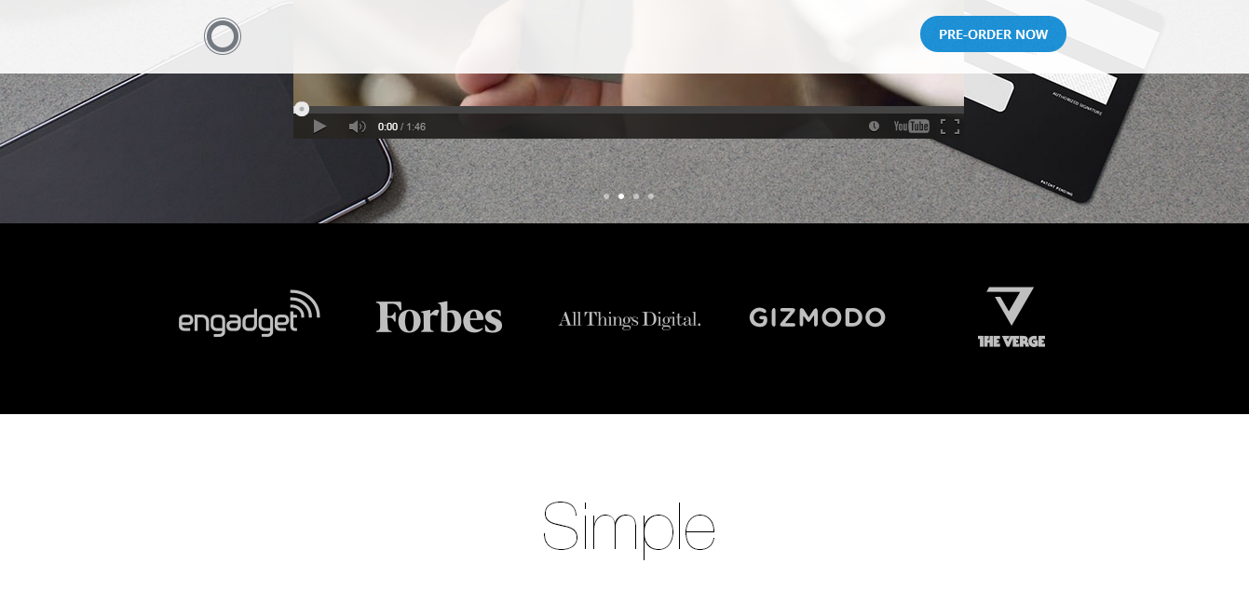
More jQuery – Window Scrolling
Window Scrolling has gotten extremely popular these days
When you scroll down a certain amount of pixels, some action occurs

Slide 10
More jQuery – Window Scrolling
We use $(window) and bind a scrolling event to it
E.g. $(window).scroll(function() { });
Next, we check where in the document we are. If greater than some pixel value, do something
We use $(document) instead of $(window). Why?
Document refers to our content on the page
It can contain elements outside the window’s height, and in this case we scroll in the window to reveal more of the document
Bind the .scrollTop() event to $(document) to check the current top pixel value on the window

Slide 11
More jQuery – Window Scrolling
$(document)
0px
Hello World
$(window)
Hello World
Sample Website
Sample Website
Content
Content
Content
Content
Content
Content
Content
Content
Content
Content
Content
Content
Content
Content
Content
Content
Content
Content
Content
Content
Content
Content
Content
Content
Content
Content
Content
Content
Content
Content
Content
Content
Content
Content
100px
$(document).scrollTop()
$(window).scroll(
function() { });

Slide 12
More jQuery – Window Scrolling
0px
Hello World
$(window).scroll(function() {
var top = $(document).scrollTop();
if(top > 100) {
// Do something
} else {
// Do something else
}
});
Sample Website
100px
Content
Content
Content
Content
Content
Content
Content
Content
Content
Content
Content
Content
Content
Content
Content
Content
Content
$(document).scrollTop()
$(window).scroll(
function() { });

Slide 13
Scrolling Demo
Follow along:
jsfiddle.net/An5Qv/2/
Answer:
jsfiddle.net/An5Qv/1/

Slide 14
More jQuery - .animate()
Similar to the multiple styles version of .css()
Except now with a time value
Use only if necessary and cannot do with CSS3 transitions
Syntax:
.animate({height: ‘40px’}, 200)
First value is wrapped in { } (JavaScript object)
Inside, you have style-value pairs with : in between
Each style-value pairs separated by comma ,
{height: ’40px’, width: ‘100px’, opacity: 0.3}
Second value is time in milliseconds

Slide 15
More jQuery - .animate()
Note:
Your styles have to be in Camel Case
Camel Case is removing hyphens – and making the next word capitalized
E.g.
font-weight → fontWeight
text-align → textAlign
background-color → backgroundColor
So:
.animate({textAlign: ‘right’, backgroundColor: ‘red’}, 400)

Slide 16
More jQuery - .animate()
Note 2:
To animate color in jQuery (font color, background color, border color, etc.), you must also include the jQuery UI library
In your <head></head> tags after loading the jQuery script, add the following below
<link rel="stylesheet" href="//ajax.googleapis.com/ajax/libs/jqueryui/1.10.4/themes/smoothness/jquery-ui.css" /> <script src="//ajax.googleapis.com/ajax/libs/jqueryui/1.10.4/jquery-ui.min.js"></script>

Slide 17
More jQuery - .animate()
With scrolling
Useful in combination with scrolling
E.g. Scroll to top of page, scroll to certain part of page
To scroll to top of page:
$(‘html, body’).animate({scrollTop: 0}, 200);
Bind to ‘html, body’. Why?
Some browsers attach scrollTop only to <html> not <body>

Slide 18
Scrolling Demo 2
Follow along:
jsfiddle.net/An5Qv/2/
Answer:
jsfiddle.net/An5Qv/1/

Slide 19
Forms

Slide 20
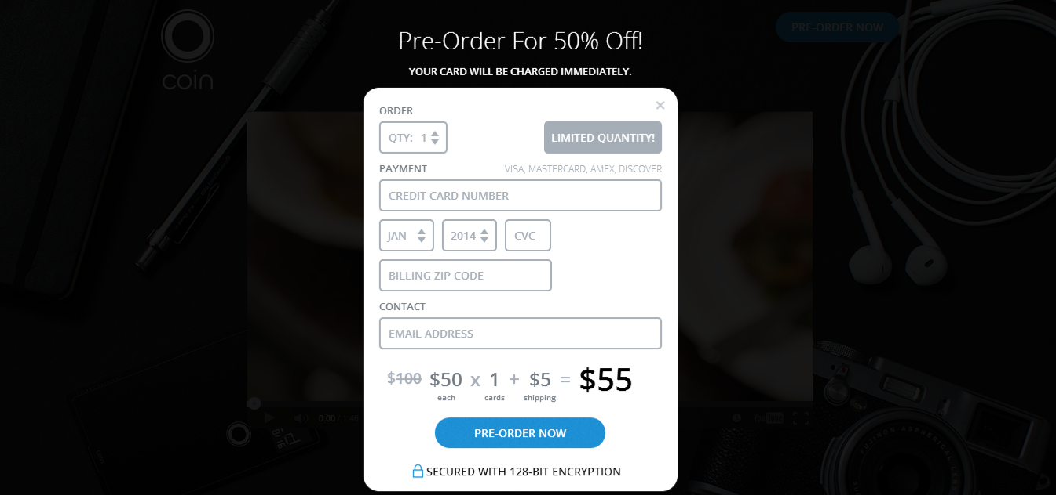
Forms
Forms are used everywhere in the web
Registration, Profile Info, Creating a Blog Post, Surveys, etc.

Slide 21
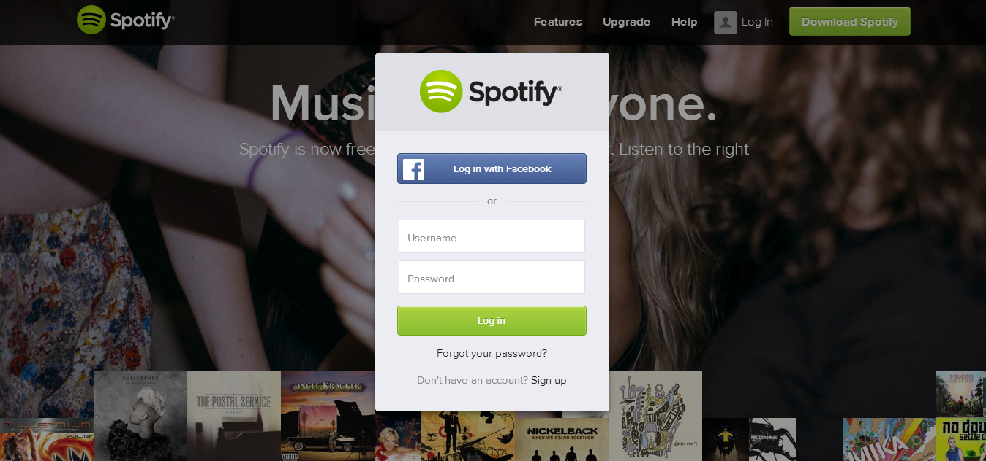
Forms
Spotify - Login

Slide 22
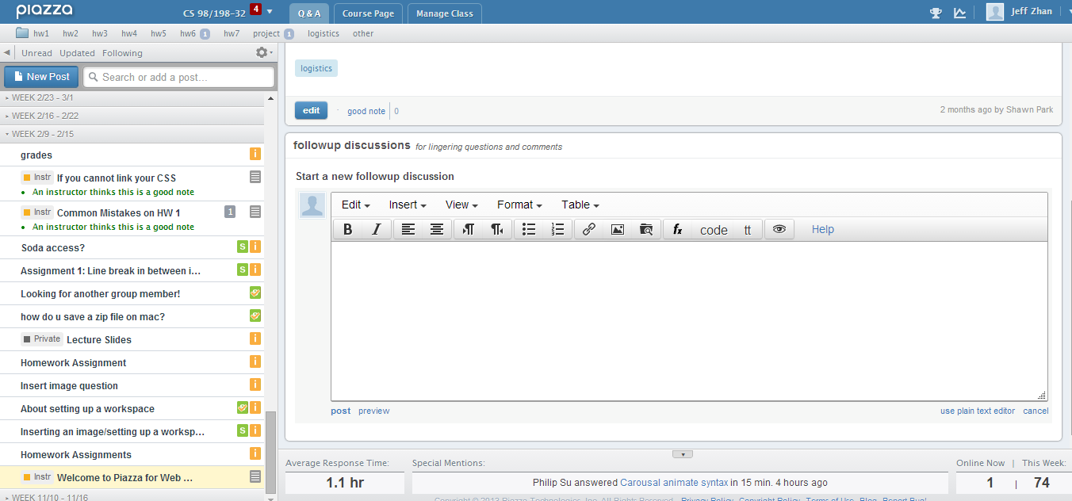
Forms
Piazza - Posts

Slide 23
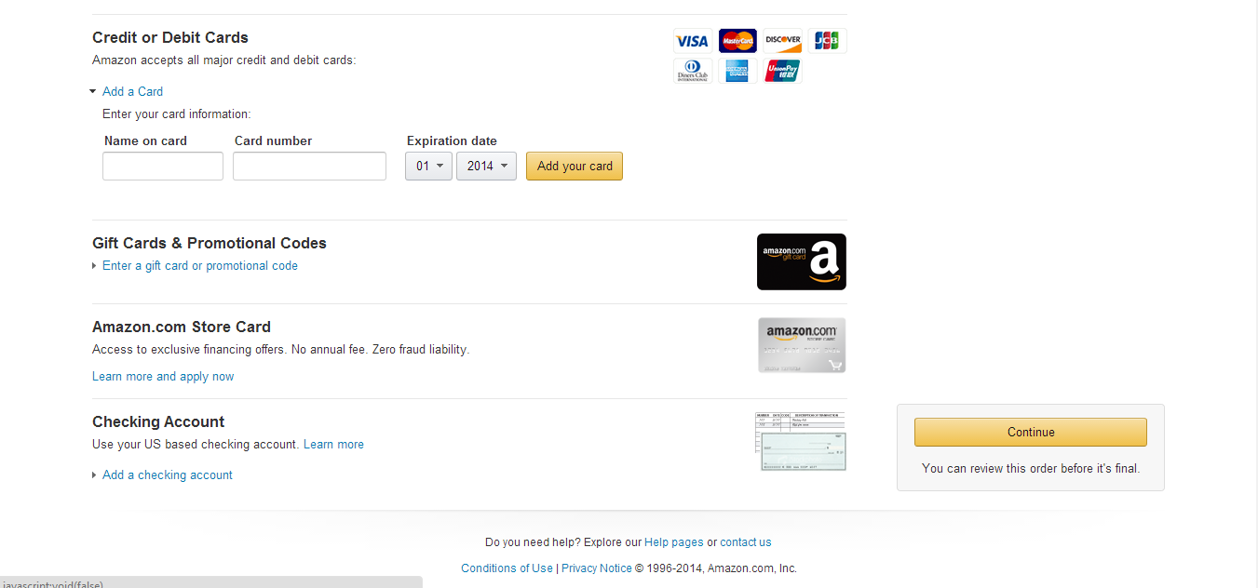
Forms
Amazon - Payment

Slide 24
Forms
Forms require knowledge of a backend (PHP, Django, Rails, etc.)
We will teach you the front-end part
Structure
Start all forms with <form> tag, end with </form>
Inside a <form> tag, many different elements
<input> tags
<textarea></textarea> tags
<select></select> tags
Notice that an <input> tag has no closing tag

Slide 25
Forms - <input>
<input> tags make use of their attribute type
Many different types
Text/Email
Simple text field. E.g. Input for name, email, address, etc.
<input type=“text”> or <input type=“email”>
John Smith
Password
Used for hidden text (passwords/confirm passwords)
<input type=“password”>

Slide 26
Forms - <input>
Orange
Apple
Checkbox
Select none, one, or multiple items
<input type=“checkbox” value=“orange”> Orange <input type=“checkbox” value=“apple”> Apple
Male
Female
Radio
Select only one in the group of items
This group is noted by the attribute name
<input type=“radio” name=“sex” value=“male”> Male <input type=“radio” name=“sex” value=“female”> Female

Slide 27
Forms - <input>
Submit
Takes in an attribute value which is the text for the button
<input type=“submit” value=“Submit”>
Submit
Summary of Input Types
text/email
password
checkbox
radio
submit

Slide 28
Forms - <textarea>
Textarea
Useful for text that may have multiple lines (comments/posts)
Has a closing tag </textarea> unlike input
Some textarea area tag that spans multiple rows, such as this example.
CSS Styles
Remember, these tags can be styled in CSS
E.g. input { width: 100px; } textarea { height: 300px; }

Slide 29
Forms - <select>
Select
Drop-downs. Works kind of like <ul> and <li>
Select tags contain <option></option> tags inside
<select>
<option>Pasta</option>
<option>Burritos</option>
<option>Pizza</option>
<option>Spaghetti</option>
</select>
Pasta

Slide 30
Forms - Example
<form>
User Registration: <br>
First Name: <input type=“text”><br>
Last Name: <input type=“text”><br>
Password: <input type=“password”><br>
Confirm Password: <input type=“password”><br>
Sex:
<input type=“radio” name=“sex” value=“male”>Male
<input type=“radio” name=“sex” value=“female”>Female<br>
<input type=“submit” value=“Submit”>
</form>
This is a super simplified version, but you get the gist. You may also may to attach IDs to those input fields.

Slide 31
Form Example
Follow along:
jsfiddle.net/RF6t2/

Slide 32
Form Validation
What is Form Validation?
Checking the form for errors before it is actually submitted
What kinds of errors?
No empty fields
Password longer than some length
Password contains special characters
Username does not exist already (for registration)
Confirm password matches password
Select option is chosen
Email is in proper format
Etc.
Lots can go wrong with a form!

Slide 33
Form Validation
Enhanced Form Structure
<form>
<div id=“email-error” class=“error”></div>
<div id=“email”>
Email: <input type=“text”>
</div>
<div id=“password-error” class=“error”></div>
<div id=“password”>
Password: <input type=“password”>
</div>
<input type=“submit” value=“Submit”>
</form>
If we click submit and email/password fields don’t meet our criteria, we can use jQuery to insert errors in the error elements.

Slide 34
Form Validation
Enhanced Form Structure
<div id=“password-error” class=“error”></div>
$(‘form’).submit(function(event) {
if($(‘#password’).length < 8) {
$(‘#password-error’).text(‘You need at least 8 characters!’);
event.preventDefault();
}
});
.submit() is an event listener for the form
If password does not meet our standards, give an error and prevent the default action of the form (submitting to our backend PHP, Django, etc.)

Slide 35
In-Class Activity
Form Validation
jsfiddle.net/5RP63/3/

Slide 36
Final Note
This concludes our final lecture on JavaScript/jQuery
Lots of resources online if you want to dive deeper
Libraries/Frameworks
jQuery is one but many JavaScript libraries that make our web developing lives easier
Others to check out:
AngularJS
Backbone.js
Node.js
MooTools
Coffee Script
D3 (super sick visualizations)
Three.js (JavaScript 3D graphics/modeling)

Slide 37
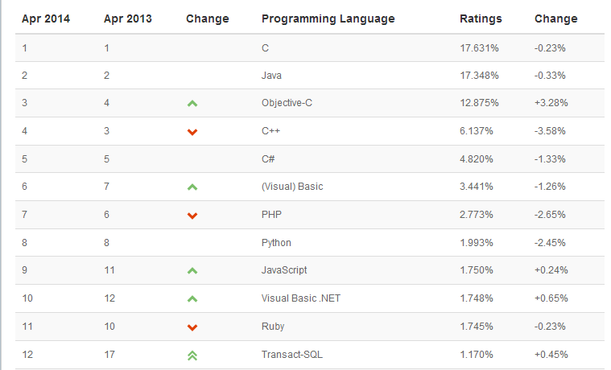
Final Note
You now have in your arsenal of skills jQuery & JavaScript! In addition to HTML and CSS ☺
JavaScript is always growing!

Slide 38
Final Notes
Job Potential
All of you are now Front-End Developers
Skill of HTML, CSS, and JavaScript (of course you have to dive in more of all 3)
Mobile web design is trending, HTML5 programming is trending
Try freelance developing, for student orgs, or intern as a developer!

Slide 39



Final Notes
Back-End
Learn back-end frameworks like PHP, Django, or Ruby on Rails
PHP is the easiest to pick up, Rails may be harder for non-CS
Django uses Python
Takes longer than front-end to learn
Consider CS169 (some semesters use Ruby on Rails)
Databases
Back-end languages communicate with the database
Store user data, website data, etc.
MySQL, PostGres, SQLite3, MongoDB (NoSQL)

Slide 40
Final Notes
Companies & Web Languages
All use JavaScript
Facebook – PHP & Python
Google – Python (Django)
Yahoo – PHP
LinkedIn – Node.js (JavaScript)
Github – Ruby on Rails
Twitch.tv – Ruby on Rails

Slide 41
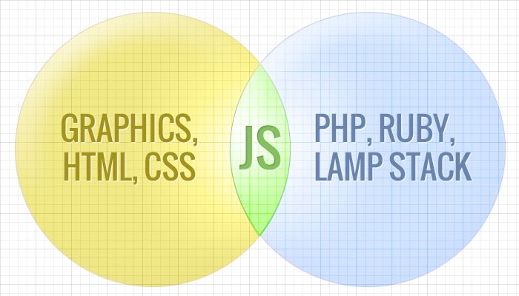
Final Notes
The Bridge between Front-End and Back-End
JavaScript is often the bridge between these two ends
Learn AJAX (communicates between front and back end)
Google Maps pioneered this
Full-Stack Engineer
Know Front and Back-End
Try your own projects that involve a back-end & database!

Slide 42
Summary
More jQuery
Chaining
.each()
.animate()
.scroll()
Forms
Input tags, Textarea, Select
Form Validation checks for errors before submitting form
All lecture material, handouts, and homework can be found at:
http://www.thewebdesignworkshop.co

